Slide 1

Introduction to Blockchain Technology – Course Introduction
Scope, Objective, Target Audience, Schedule
SoftUni Team
Technical Trainers
Software University
http://softuni.bg

Slide 2
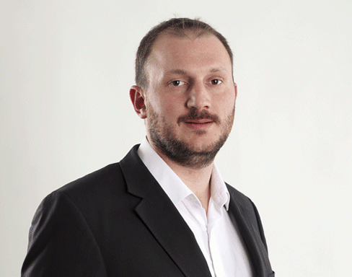
The Trainer
Mihael Mladenov
Full-Stack Software Developer
Crypto Investor
Lecturer at Software University

Slide 3
You Have Questions?
sli.do #B-Chain-Intro

Slide 4







Quality Digital Education for Thousands of Young People

Slide 5



Directions at SoftUni
DIGITAL MARKETING
(7 month program)
DESIGN AND CREATIVE
(11 month program)
PROGRAMMING FOR KIDS
( 1- 6 grade)

Slide 6


Directions at SoftUni (2)
“Software University“ Fondation
(free trainings,books and educational content)
Private High School for Digital Skills
(приложно programming, graphic design, digital marketing)

Slide 7

Types of Education
Presently | Online
Direct access to lecturers and assistants | Virtual classroom
Present exercises | Access to training materials
Direct access to colleagues | Contact the lecturer via sli.do
Ability to work in a team

Slide 8
Diploma and Certificates
Diploma for Professions from SoftUni
JavaScript Developer: 80 + credits
PHP Developer: 80 + credits
C# Web Developer: 150 + credits
Java Web Developer: 150 + credits
Each Course at SoftUni gives you several credits
(depends on the difficulty, the scope
of the course and
the evaluation at the end)

Slide 9
Welcome to Software University
Main Program “Software University" @ SoftUni
Quality education, profession and work for software engineers
20 + practical courses, 20 + exams, 15 + exams → ~ 2 years
Work – career center (5.00 + scores)
Free start – each month new course

Slide 10
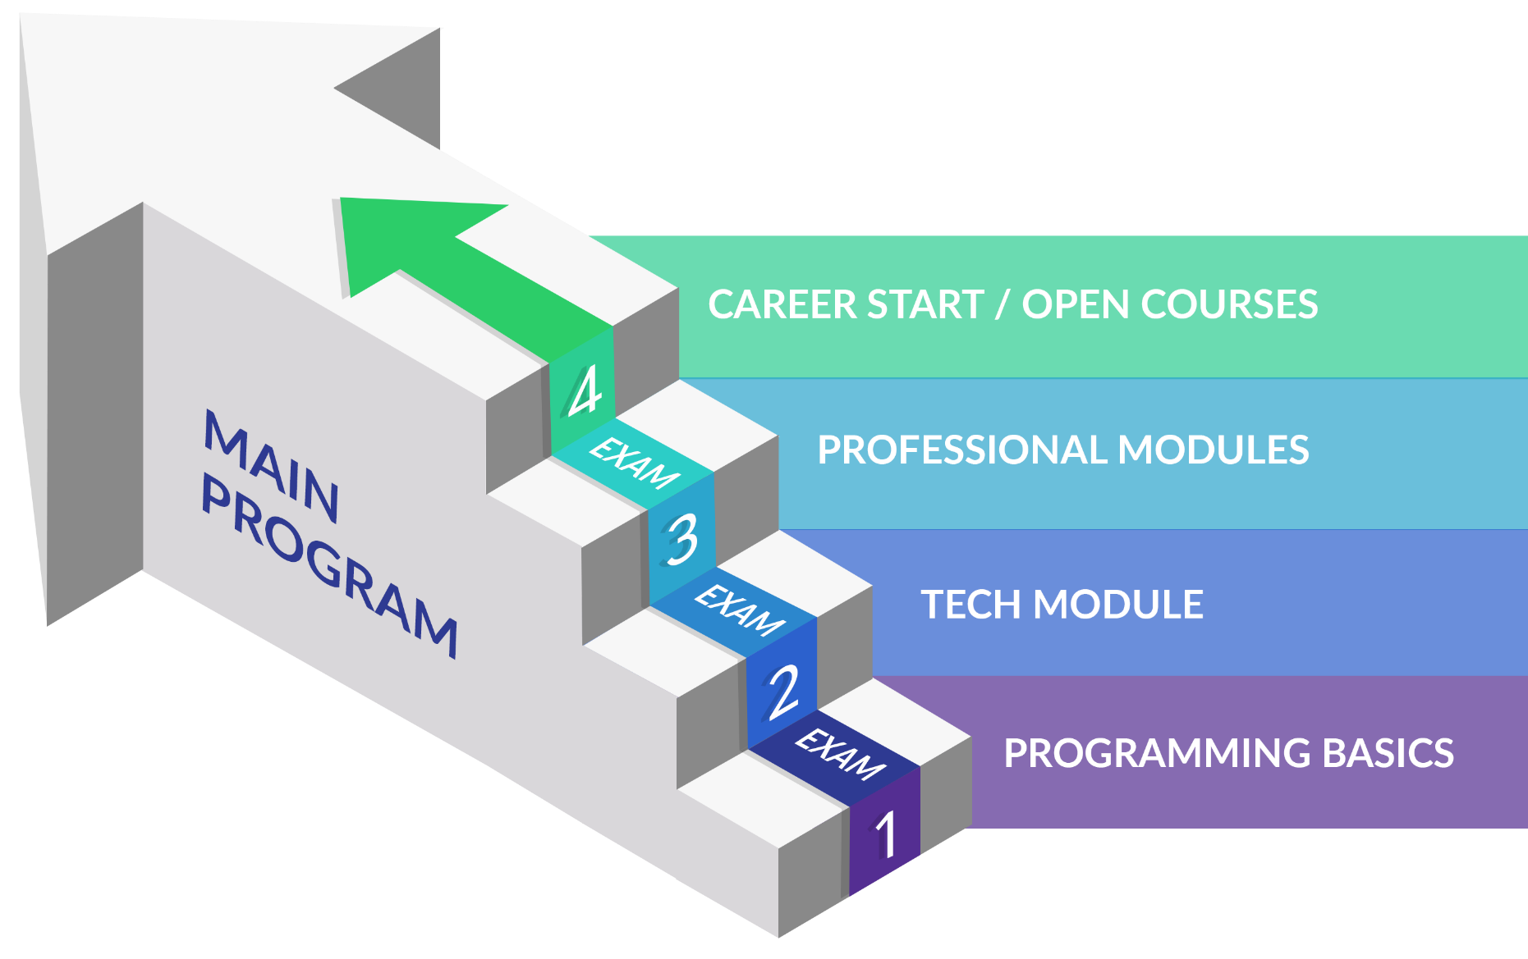
Main Program
C#, Java, PHP, JavaScript

Slide 11
Welcome to Software University
Open Courses @ SoftUni
Quality education, profession and work
Each month new course from different spheres as: Artificial Intelligence, Python, C++, Quality Assurance, Computer Networking, System Administration, Cyber Security Blockchain Technology and etc.

Slide 12
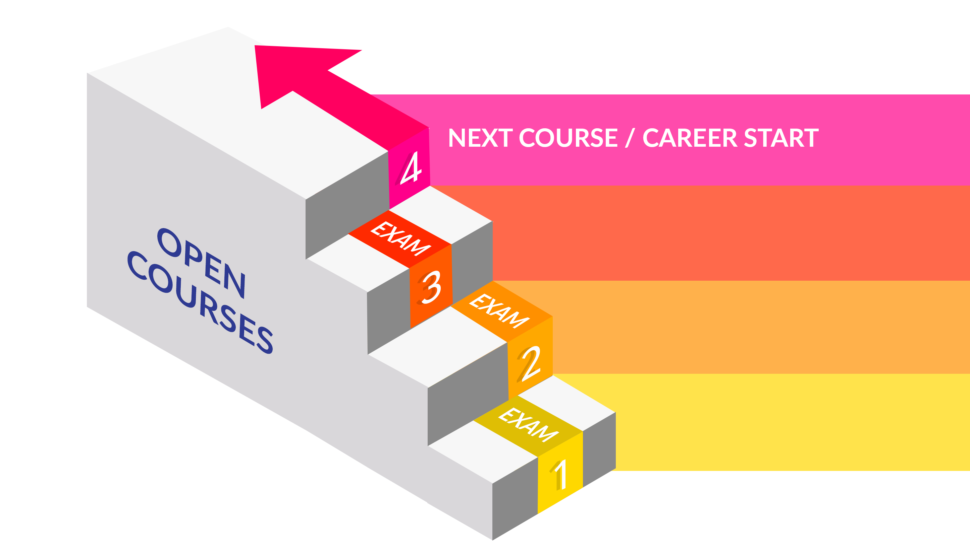
Open Courses
Quality Assurance
Smart Contract Development with Solidity
Fundamentals of Programming (with C#)
Intro to Blockchain

Slide 13
Work for Graduates
SoftUni helps students get started
Contracts with 70 + IT companies for hiring students from
SoftUni
The top students will have the opportunity to work at SoftUni
The top students will choose between a lot of employers
We do not promise work for students with poor results
Career center
Seeks job for everyone with average success 5.00+

Slide 15
Diamond Partners

Slide 16
Diamond Partners

Slide 17





Trainings @ Software University (SoftUni)
Software University – High-Quality Education, Profession and Job for Software Developers
softuni.bg
Software University Foundation
http://softuni.foundation/
Software University @ Facebook
facebook.com/SoftwareUniversity
Software University Forums
forum.softuni.bg

Slide 18

License
This course (slides, examples, demos, videos, homework, etc.) is licensed under the "Creative Commons Attribution-NonCommercial-ShareAlike 4.0 International" license

